Slide 1
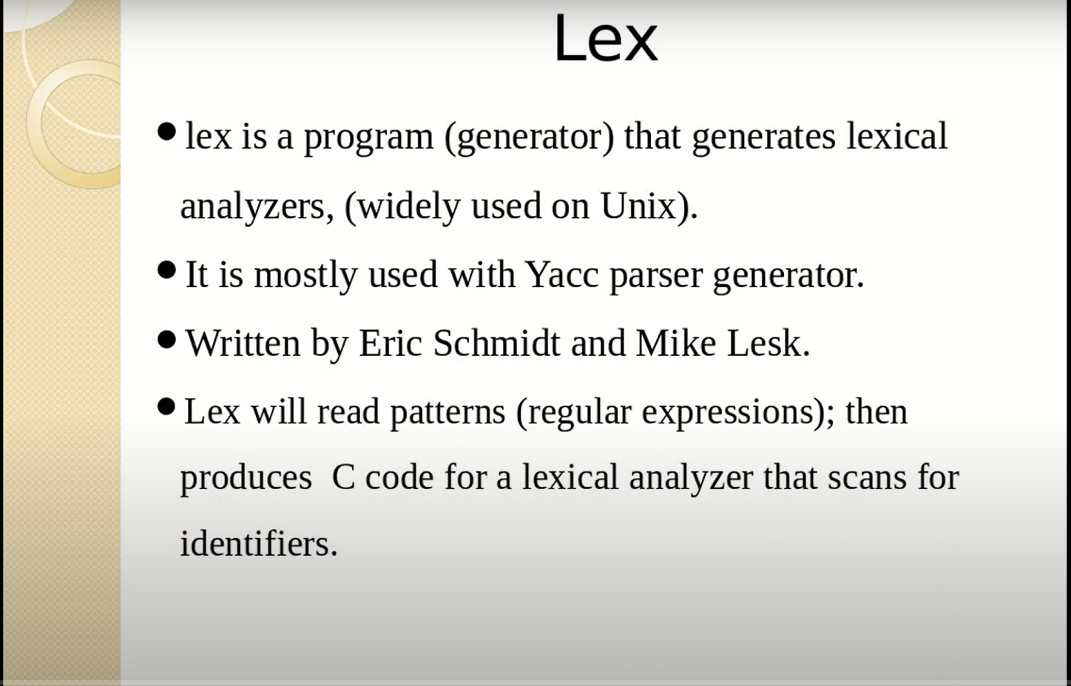

Slide 2
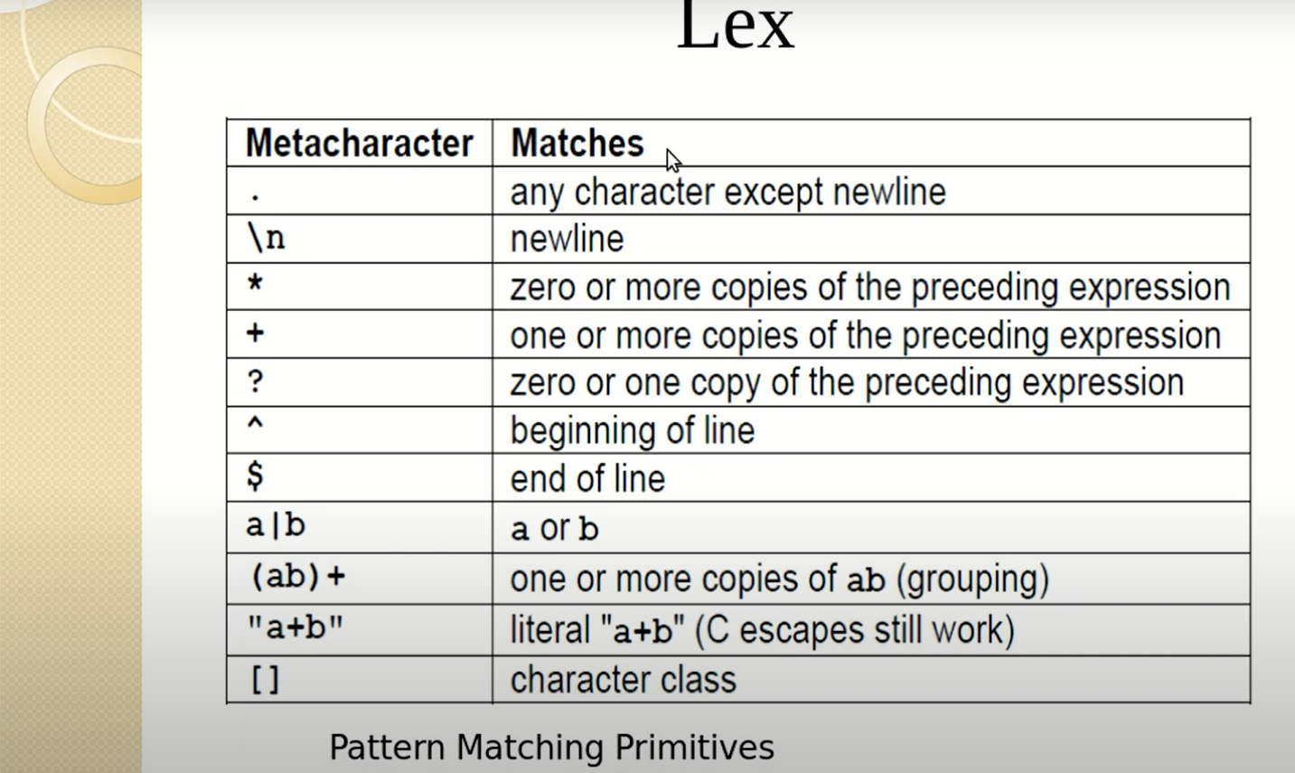

Slide 3
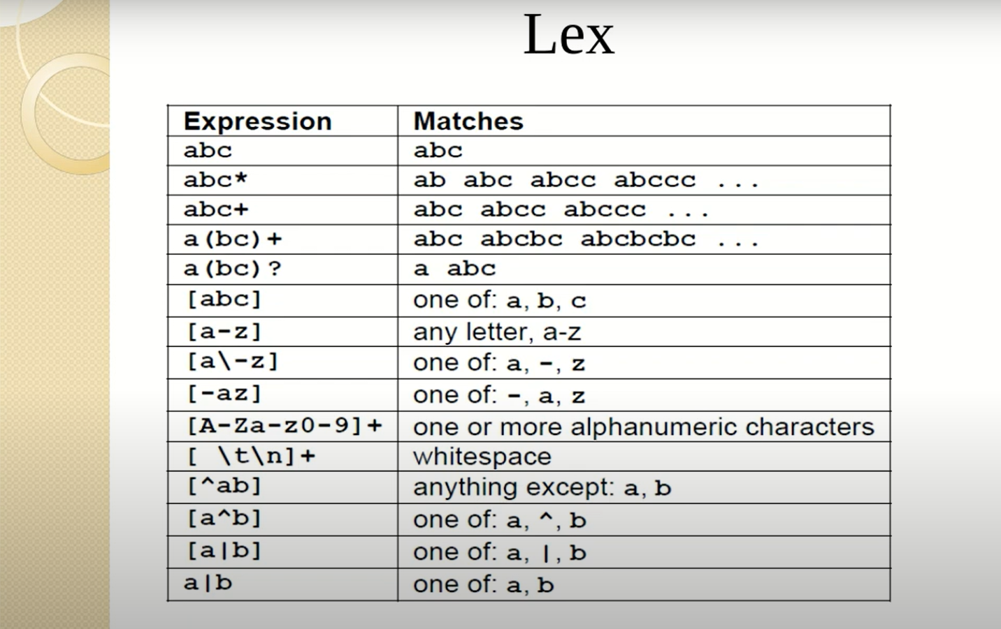

Slide 4
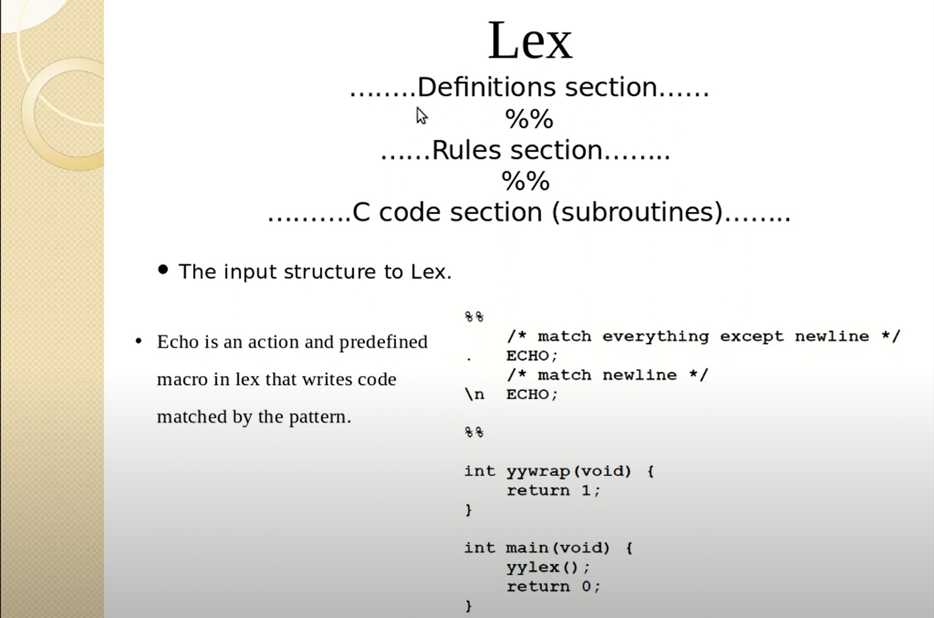

Slide 5
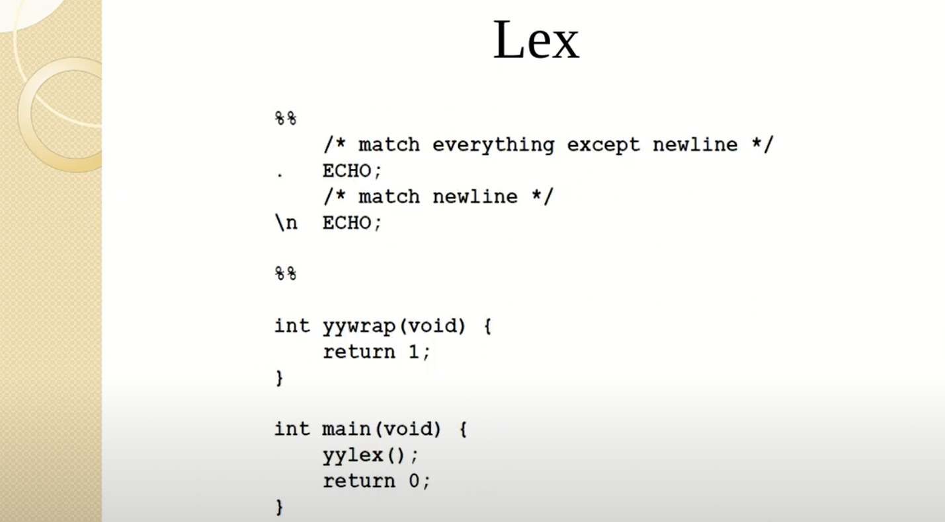

Slide 6
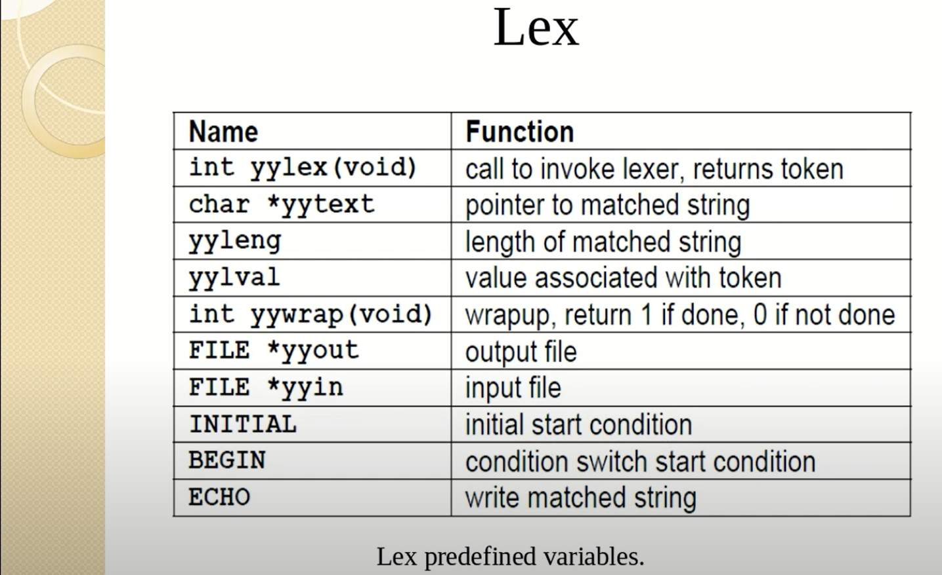

Slide 7
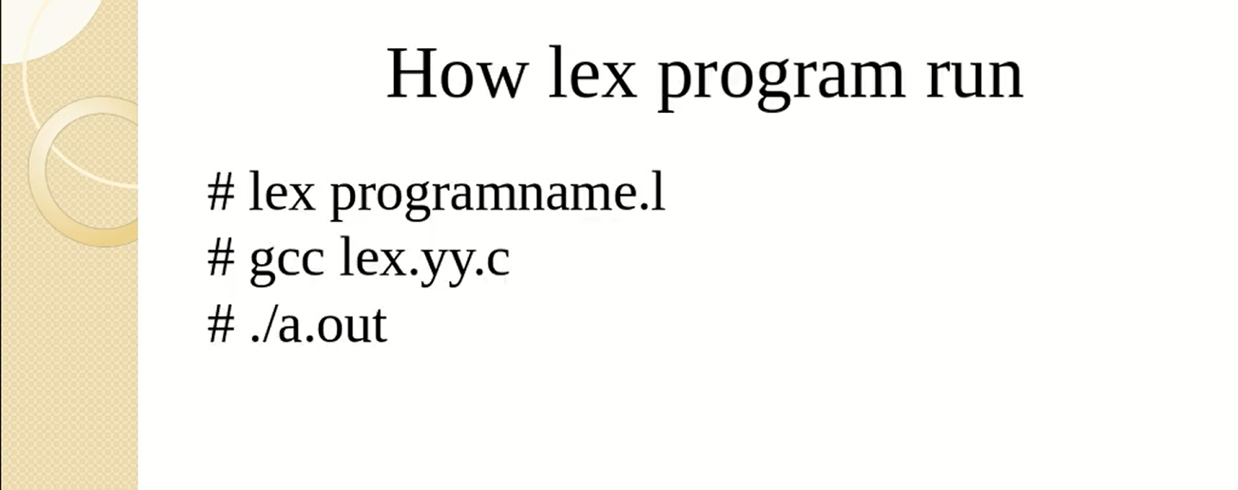

Slide 8
Metacharacters
The simplest example of a metacharacter is the full stop.
‘ . ’
The full stop character matches character of any sort (apart from a newline).
For example, the regular expression ".at" means: any letter, followed by the letter `a', followed by the letter `t'.
".at" = The cat sat on the mat .

Slide 9
Character sets
‘[‘ and ‘]’
Square brackets in a regular expression are used to indicate a character set. A character set will match any character in the set.
For example, the regular expression "[Tt]he" means: an uppercase `T' or a lowercase `t', followed by the letter `h', followed by the letter `e'.
"[Tt]he" = The cat sat on the mat.
Within square brackets, common ranges may be specified by start and end characters, with a dash in between, e.g., 0-9 for the Arabic numerals.
For example, the regular expression "[a-z]at" means: any (English) lowercase letter, followed by the letter `a', followed by the letter `t'.

Slide 10
"[a-z]at" = The cat sat on the mat .
If a hat character (^)appears as the first character within square brackets, the set is inverted so that a match occurs if any character other than the set specified within the square brackets is found.
For example, the regular expression "[^c]at" means: any letter except `c', followed by the letter `a', followed by the letter `t'.
"[^c]at" = The cat sat on the mat .
Within square brackets, most metacharacters revert to their literal meaning. For example, [.] means a literal full stop.
For example, the regular expression "at[.]" means: the letter `a', followed by the letter `t', followed by a full stop.
"at." = The cat sat on the mat.
"at[.]" = The cat sat on the mat.

Slide 11
Regular expression character classes.
[:alpha:] Alphabetic (only letters)
[:lower:] Lowercase letters
[:upper:] Uppercase letters
[:digit:] Digits
[:alnum:] Alphanumeric (letters and digits)
[:space:] White space
[:punct:] Punctuation
For example, the regular expression "[[:lower:]]at" means: any lowercase letter in any language, followed by the letter `a', followed by the letter `t'.
"[[:lower:]]at" = The cat sat on the mat .

Slide 12
Anchors: Anchors do not match characters. Instead, they match a piece of text, such as the start (^) and end ($) of the text.
‘^’
The “hat” character (^) matches the start of a piece of text or the start of a line of text. Putting this at the start of a regular expression forces the match to begin at the start of the text. Otherwise, the pattern can be matched anywhere within the text.
For example, the regular expression "^[Tt]he" means: at the start of the text an uppercase `T' or a lowercase `t', followed by the letter `h', followed by the letter `e'.
"[Tt]he" = The cat sat on the mat.
"^[Tt]he" = The cat sat on the mat.

Slide 13
‘$’
The dollar character matches the end of a piece of text. This is useful for ensuring that a match finishes at the end of the text.
For example, the regular expression "at.$" means: the letter `a', followed by the letter `t', followed by any character, at the end of the text.
"at." = The cat sat on the mat.
"at.$" = The cat sat on the mat.

Slide 14
Alternation
‘|’
The vertical bar character subdivides a regular expression into alternative subpatterns. A match is made if either the pattern to the left of the vertical bar or the pattern to the right of the vertical bar is found.
For example, the regular expression "cat|sat" means: the letter `c', followed by the letter `a', followed by the letter `t', or the letter `s', followed by the letter `a', followed by the letter `t'.
"cat|sat" = The cat sat on the mat.

Slide 15
Repetitions
Three metacharacters are used to specify how many times a subpattern can repeat. The repetition relates to the subpattern that immediately precedes the metacharacter in the regular expression.
‘?’
The question mark means that the subpattern can be missing or it can occur exactly once. For example, the regular expression "at[.]?" means: the letter `a', followed by the letter `t', optionally followed by a full stop.
"at[.]" = The cat sat on the mat.
"at[.]?" -The cat sat on the mat.
‘*’
The asterisk character means that the subpattern can occur zero or more times.

Slide 16
‘+’
The plus character means that the subpattern can occur one or more times.
For example, the regular expression "[a-z]+" means: any number of (English) lowercase letters in a row.
"[a-z]+" – The cat sat on the mat .
As an example, the regular expression "c.+t" means: the letter `c', followed by any number of any character at all, followed by the letter `t'.
"c.+t" = The cat sat on the mat .

Slide 17
Grouping
‘(‘ and ‘)’
Parentheses can be used to define a subpattern within a regular expression.
For example, the regular expression "(c|s)at" means: the letter `c' or the letter `s', followed by the letter `a', followed by the letter `t'.
"(c|s)at" = The cat sat on the mat.
The regular expression "(.at )+" means one or more repetitions of the following pattern: any letter at all, followed by the letter `a', followed by the letter `t', followed by a space.
"(.at )+" = The cat sat on the mat.
Grouping is also useful for retaining original portions of text when performing a search-and-replace operation.

Slide 18
Backreferences: It is possible to refer to previous subpatterns within a regular expression using backreferences.
‘\n’
When parentheses are used in a pattern to delimit subpatterns, each subpattern may be referred to using a special escape sequence: \1 refers to the first subpattern (reading from the left), \2 refers to the second subpattern, and so on.
For example, the regular expression "c(..) s\\1" means: the letter `c', followed by any two letters, followed by a space, followed by the letter `s', followed by whichever two letters followed the letter `c'.
"c(..) s\\1" = The cat sat on the mat.

Slide 19
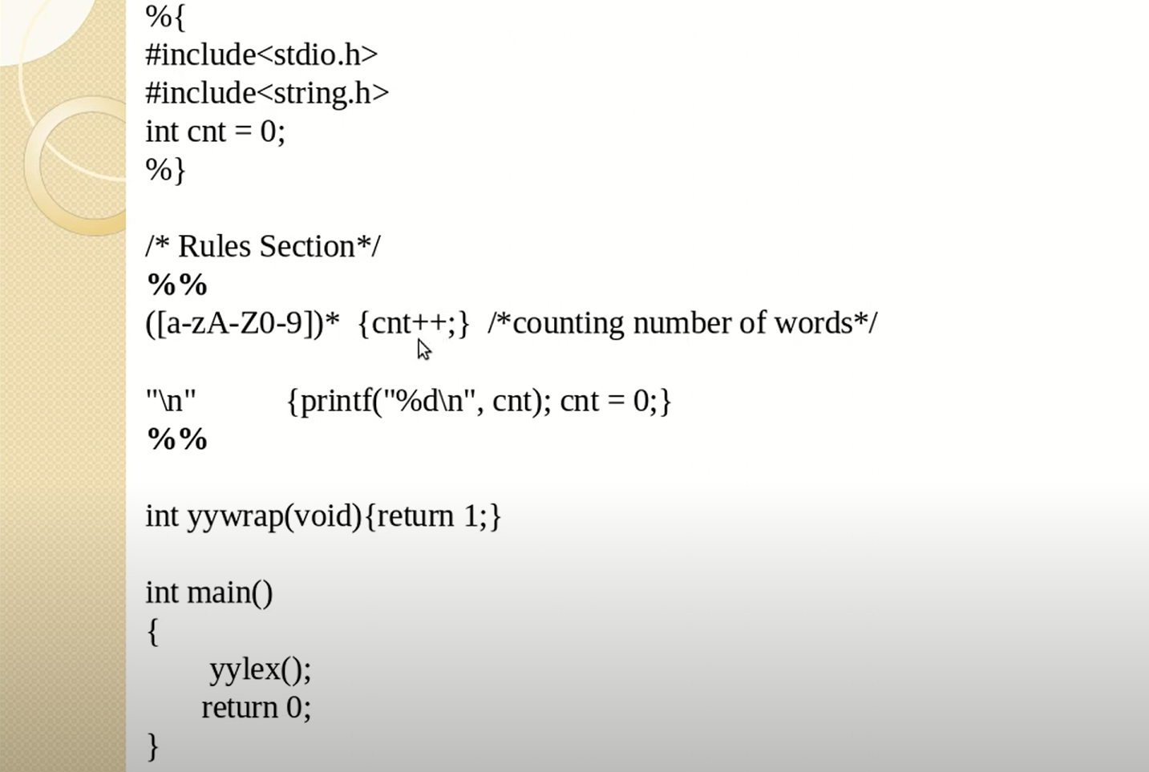
1. Lex program to count the number of words

Slide 20
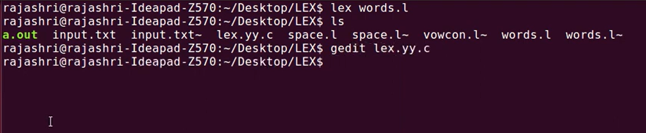
To run a Lex Program

Slide 21
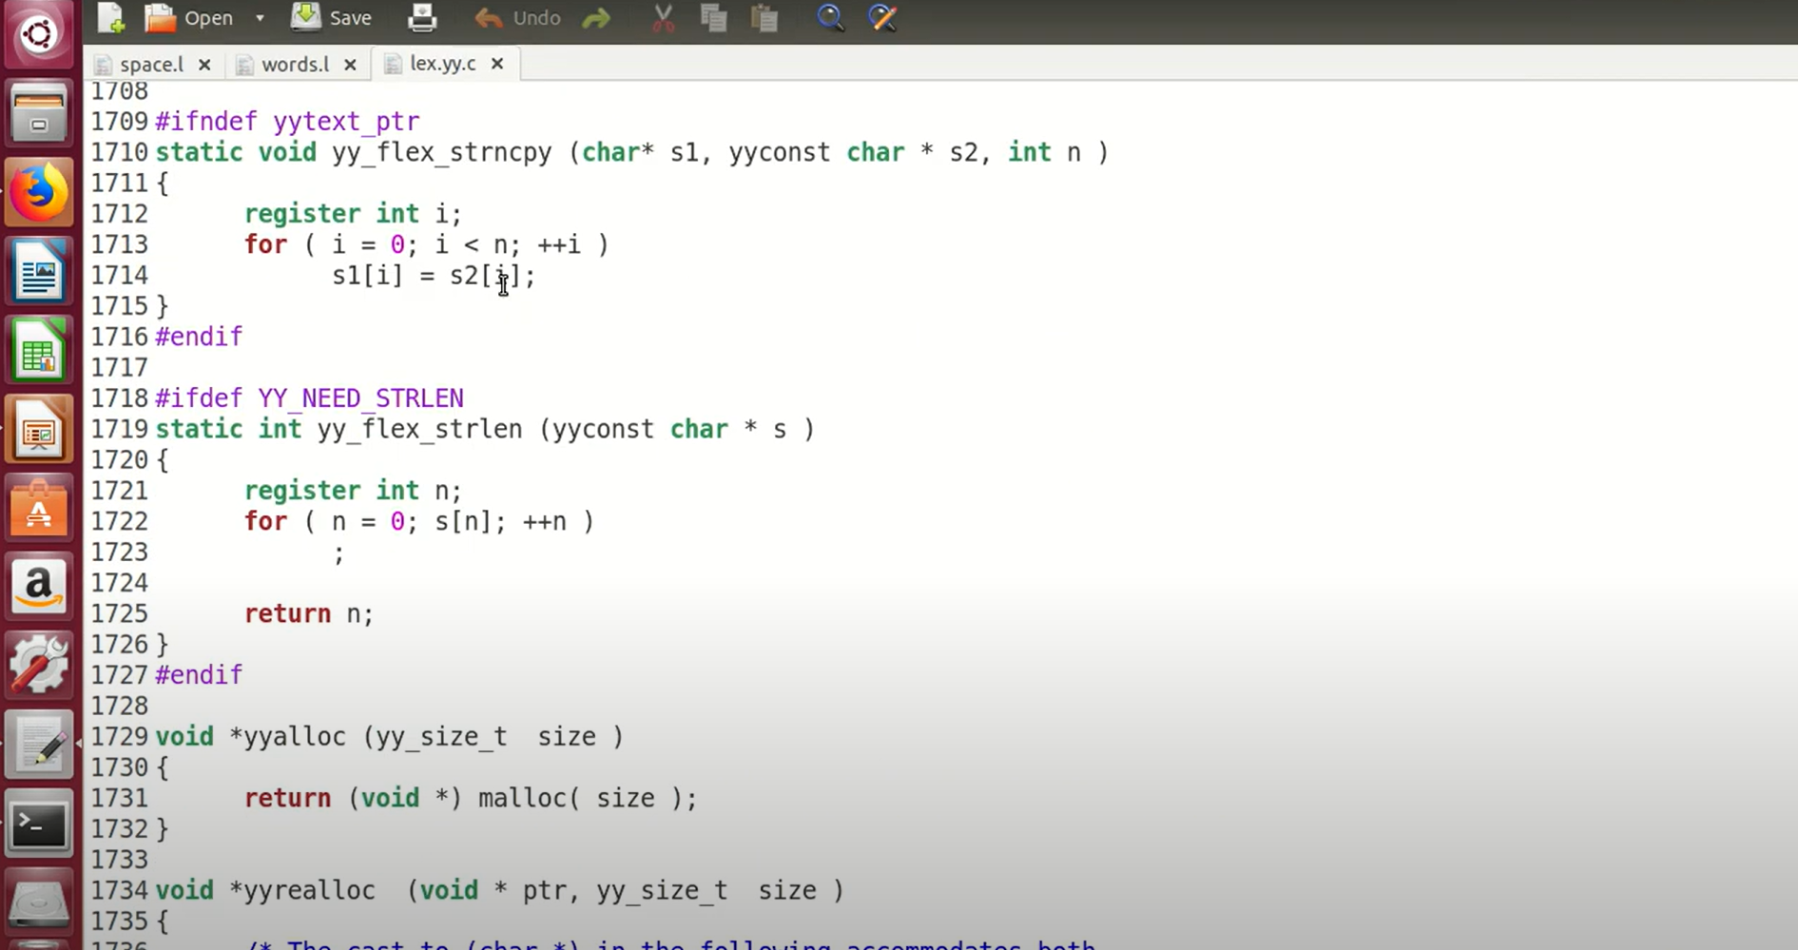
Lex.yy.c file

Slide 22
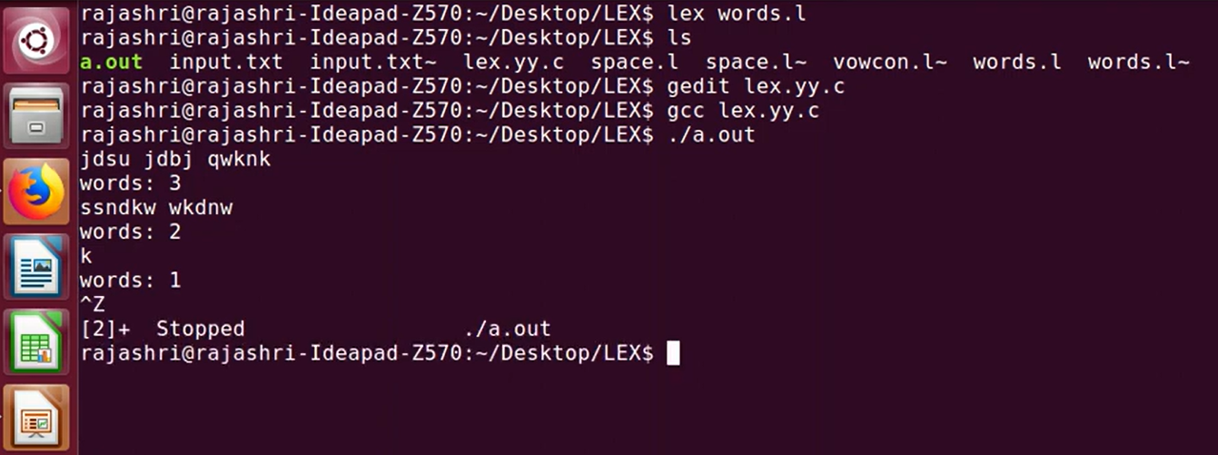
File execution and its output

Slide 23
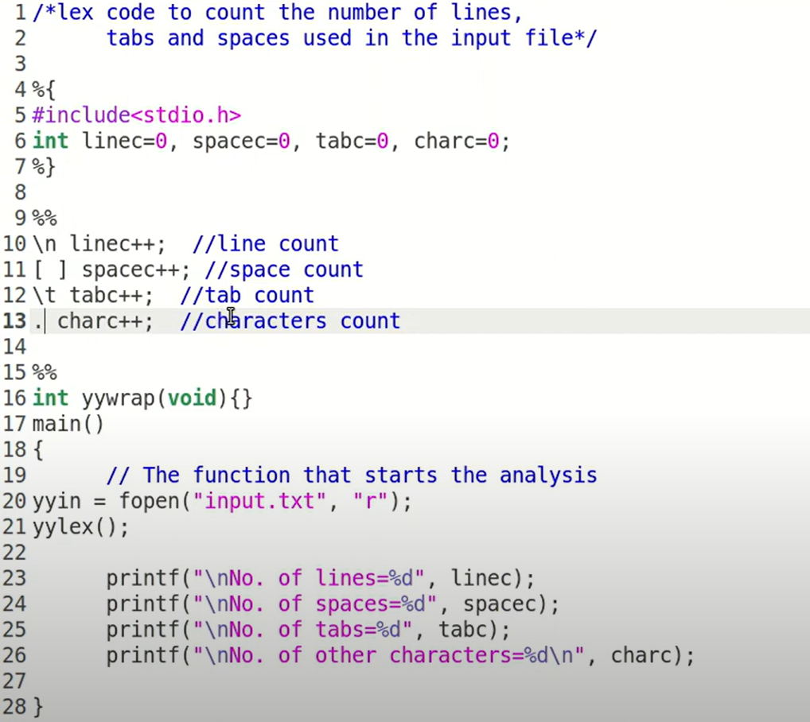
2. Lex program to count the number of lines, tabs, spaces

Slide 24
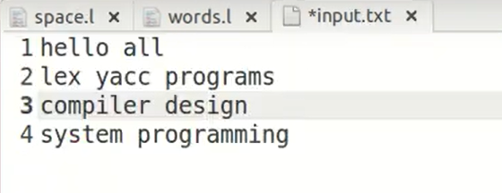
2. Lex program to count the number of lines, tabs, spaces
Input file

Slide 25
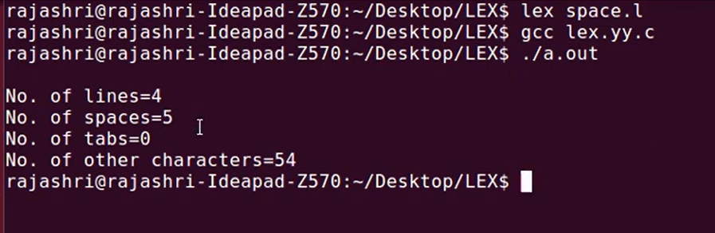
2. Lex program to count the number of lines, tabs, spaces
Output:

Slide 26
/* match everything except newline */ . ECHO; /* match new line */ \n ECHO; %% a?

